Slide 1
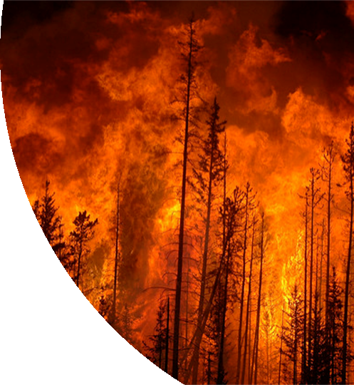
CMPE 257 Project: Wildfire Risk Analysis and Prediction
Project group 6
Team members:
Akshay Kumar Gyara (013836277)
Nithya Kuchadi (013769665)
Nasrajan Jalin (013784420)
Shalu Rani (012565046)

Slide 2
Introduction
Number of wildfire incidents are increasing every year causing a lot of damage to the environment, lives, and property.
Combination of fire, vegetation, climate, humans, and weather make it difficult to predict.
Key factors: biomass, wind speed, terrain, temperature, humidity etc.
In this project we shall use spatial images of a particular county which has both signs of smoke and no sign of smokes to train the model.

Slide 3
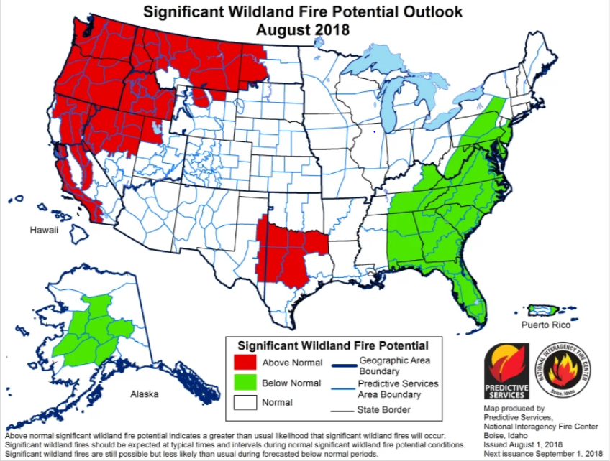
Fig below showing the areas prone to wildfire by recent reports by National Interagency Fire Center

Slide 4
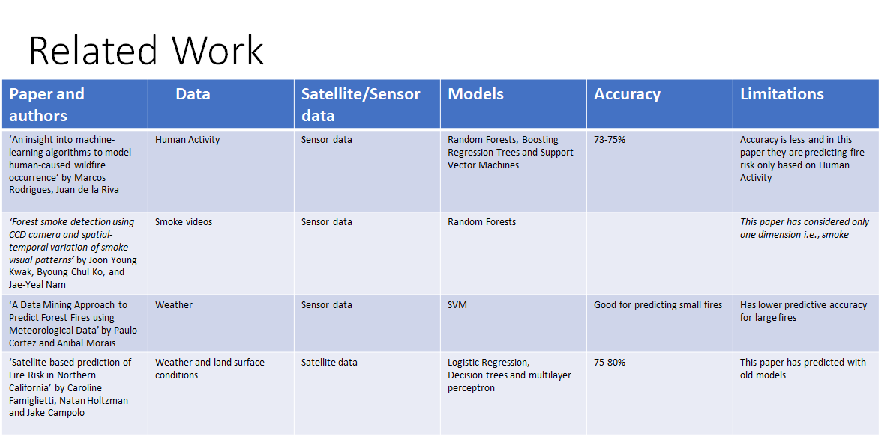

Slide 5
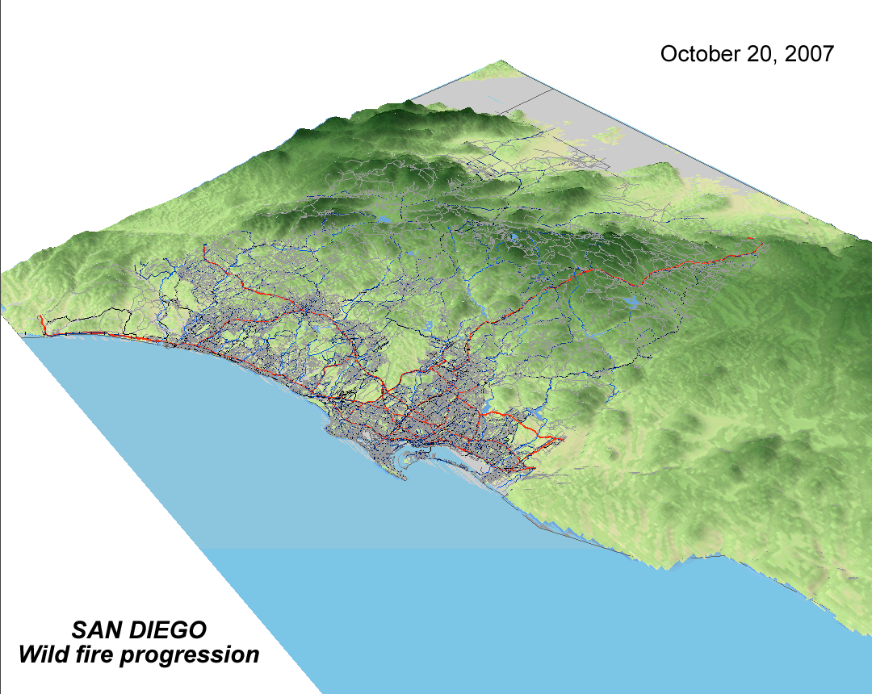
Training Data and Visualizations
The overall data set is a combination of satellite and sensor data depicting the following 3 dimensions -
Weather
Terrain
Fire- historic data

Slide 6
Data Preprocessing
Data Preprocessing refers to applying transformation to our data before feeding into the algorithm. In simple terms it mean to convert raw , messy data in to clean data.
For achieving better results from Machine learning models it is necessary to have the data in clean and proper format. We used the below 3 process to clean data
Normalization
Dimensionality reduction
Hold out plus k-fold cross validation

Slide 7
Data Preparation
Data preparation is a task of converting data from a given form to a much more usable and desired form i.e. making it more meaningful and informative. We will be using the below steps to process the data
Collected data from various sources
Analyzed data for correctness
Cleaned data
Visualized data for correlations using Seaborn heatmaps and plots
Removed least correlated attributes
Labeled the data to 0 (“no fire”) and 1 (“fire”) using fire history of San Diego as a reference.

Slide 8
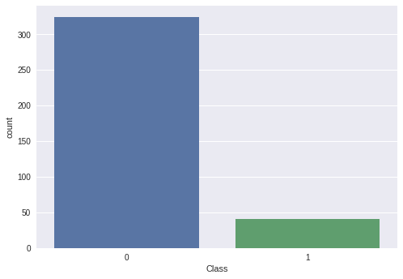
Weather Data
The goal of this dimension is to provide data analytics and insights into the relationship between weather and the possibility of wildfire at San Diego County. The weather data were obtained from various sources.
The structure of the weather data has been given below:

Slide 9
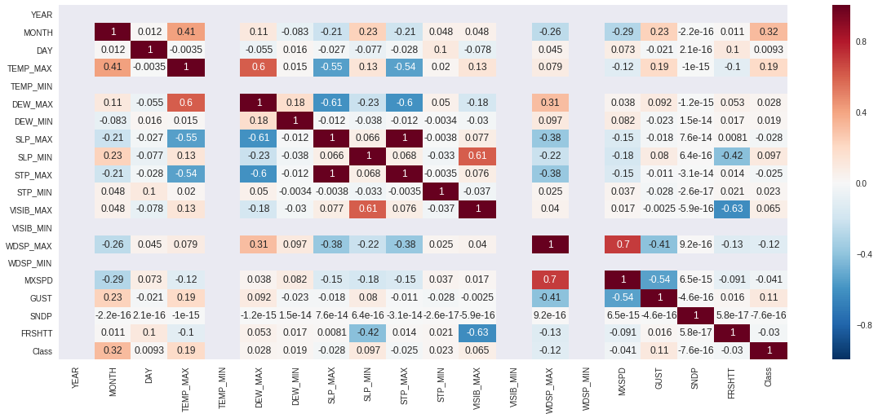
Data Correlation
The below shown image is basically a covariance matrix. Also known as the auto-covariance matrix, dispersion matrix, variance matrix, or variance-covariance matrix. It is a matrix in which i-j position defines the correlation between the ith and jth parameter of the given weather data-set.

Slide 10
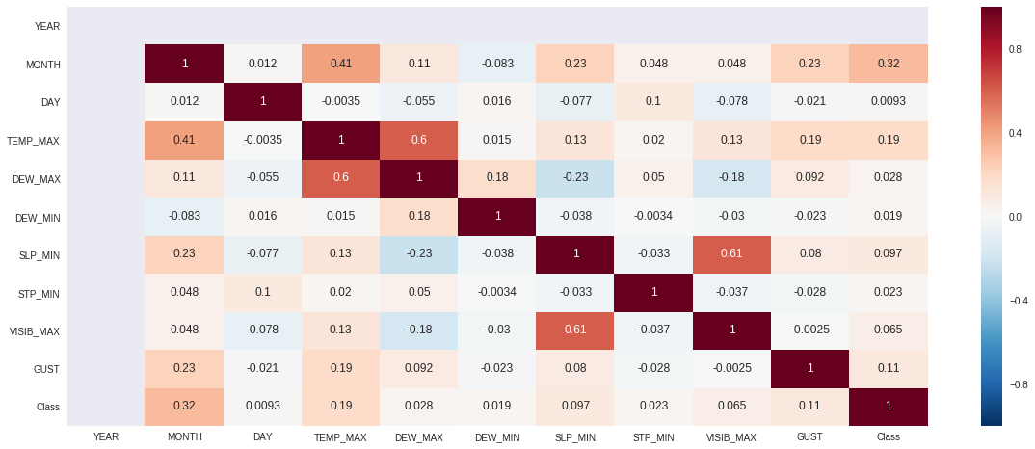
Data Correlation
The below correlation matrix is a better understanding about the relationship between the ith and jth parameter than the above matrix.
The below image shows heat Map after removing less correlated attributes.

Slide 11
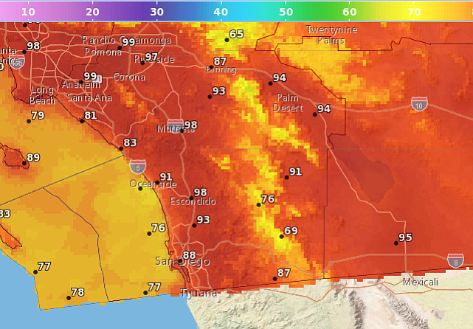
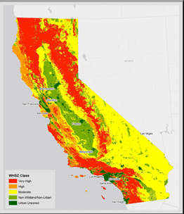
Temperature
For a county like San Diego, temperature plays a major role in causing fire. Majority of the fire incidents that we analyzed, happened when the temperature was

Slide 12
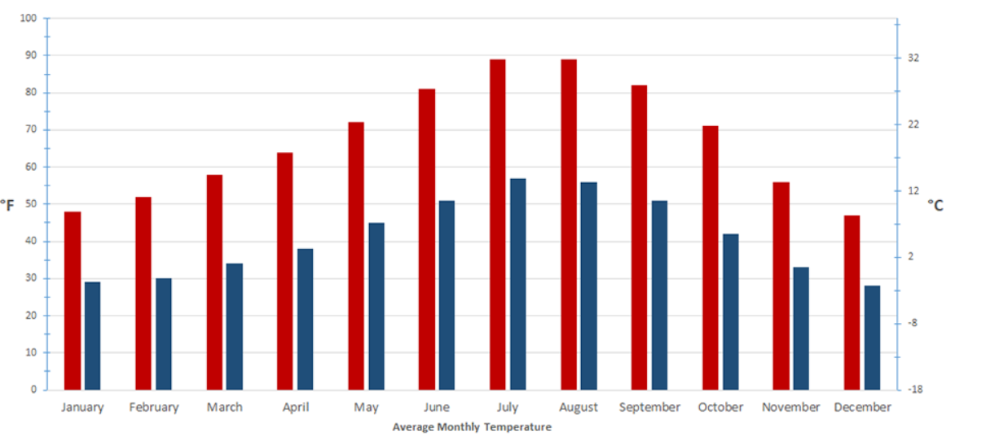
Average temperature graph for each month

Slide 13
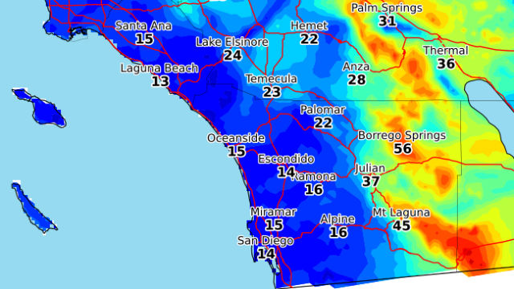
Gust
Gust has a strong effect on fire behavior due to the fanning effect on the fire. ...Wind increases the oxygen supply which results in spreading the fire more rapidly. This also removes the surface fuel moisture, which results in the drying of the fuel. Air pressure will push flames, sparks and firebrands into new fuel.

Slide 14
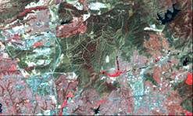
Landscape and Vegetation
The accumulated biomass in the form of dead leaves, branches etc. makes a huge impact in the ignition and spread of fire. The landscape, soil moisture content, type of vegetation in the area influences the probability of fire occurrence.

Slide 15
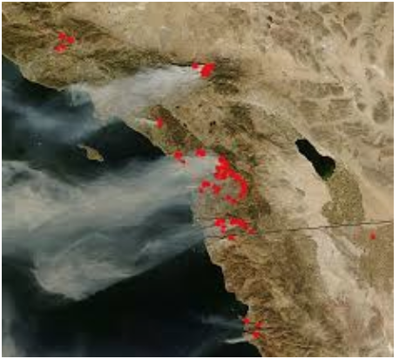
Smoke
As smoke is a key element of fire, it can be used for early detection of fire. In this project, we are going to use spatial images of a particular county which has both signs of smoke and no sign of smokes to train the model.

Slide 16
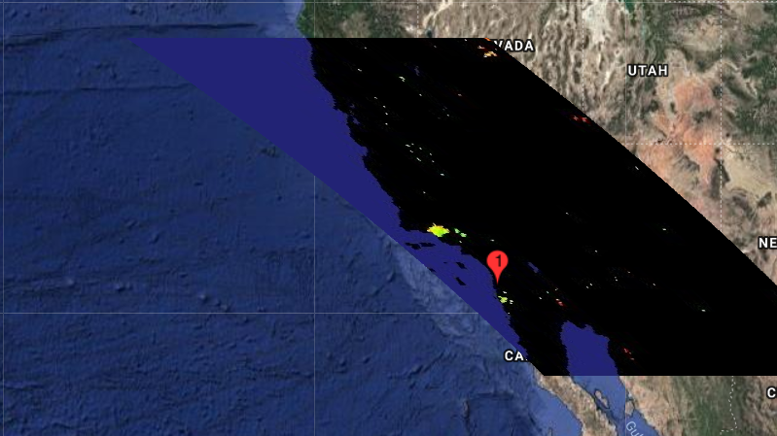
Satellite Images
As satellite data covers large areas and helps in the identification of extremely large features. Satellite images provide insights about the vegetation changes over season and the change in human activity over a terrain. In the below images the small dotted spots are the sign of fire.

Slide 17
Machine Learning Models and AI Algorithms:
We will be using the below 4 Machine learning models:
Logistic Regression:
1)Logistic regression models the probabilities for classification problems with two possible outcomes. It’s an extension of the linear regression model for classification problems.
2)In regression analysis, logistic regression is predictive analysis used when dependent variable(target) is categorical and dichotomous(e.g. yes/no; fire/no-fire etc).
3)The coefficients (Beta values) of the logistic regression algorithm must be estimated from the training data. This is done using maximum-likelihood estimation. The best coefficients would result in a model that would predict a value very close to 1 (e.g. fire) for the default class and a value very close to 0 (e.g. no-fire) for the other class.

Slide 18
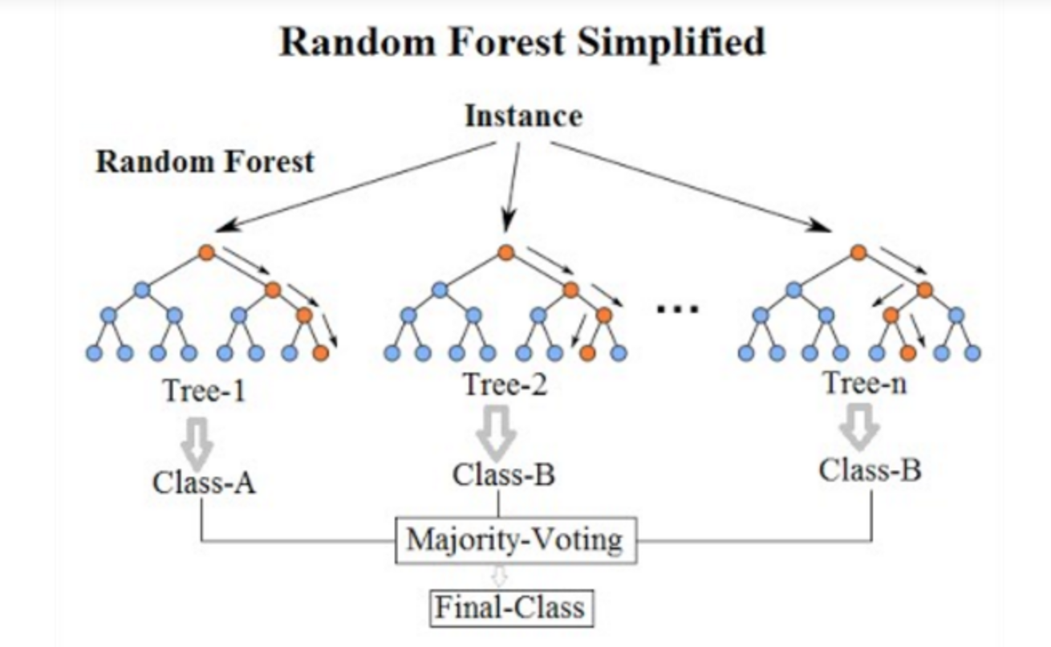
RandomForest:
1)Random Forest is one of the most widely used algorithms and works well with high dimensional data. It is flexible and gives good performance even without tuning the hyperparameter.
2) In this project we will be using sensor data of Weather, Human activity data, satellite images data of fire history and vegetation type of a specific county ie San Diego in our case to predict if there is fire or no fire.
3)Unlike decision trees where the most important feature is used for splitting the node, random forest searches for the best features among a random subset of features.

Slide 19
Convolutional Neural Network (CNN)
1)Convolutional Neural Network is a class of deep, forward-feed artificial neural networks, most commonly applied to analyzing visual imagery.
2)CNN use a variation of multilayer perceptrons designed to require minimal preprocessing.3)It takes the input image and assigns learnable weights and biases to the various features in the image.
4) A convolutional network is able to successfully capture the Spatial and Temporal dependencies in an image through the application of relevant filters.
5) We will be feeding various spatial images of both fires that occurred in the past and the vegetation type of San Diego County to make prediction of fire or no fire .
6)The positive training images dataset consists of satellite images of a specific region with signs of smoke to depict fire accident and other is negative images dataset consisting on no smoke in it.
7) For vegetation positive image datasets will be showing more of dried grass, trees, plants etc and negative images with less of dry material or greener plants or trees.

Slide 20
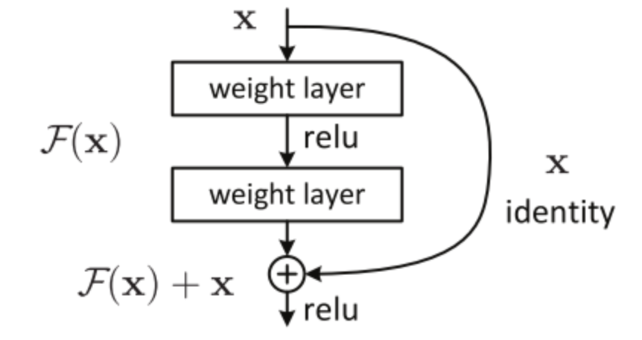
Residual Neural Network (ResNet):
1)A residual neural network is an artificial neural network of a kind that builds on constructs known from pyramidal cells
2)Residual neural networks do this by utilizing skip connections. A typical ResNet model will utilize single-layer skips.
3)ResNet can give high performance even with thousands of layers. ResNet addresses the vanishing gradient problem wherein performance gets saturated.
4)For this model also we use various spatial images of both fires that occurred in the past and the vegetation type of San Diego County to train the model and to make prediction of fire or no fire .

Slide 21
THANKYOU

